Slide 1
Expansion
tank
Electromagnetic
flow meter
Electromagnetic
flow meter
Rectangular tank
Control panel
VSD
Pressure
gauge
Torque
meter
Pressure
gauge
Fig. 1

Slide 2
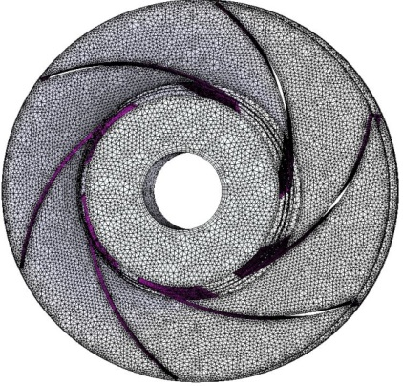
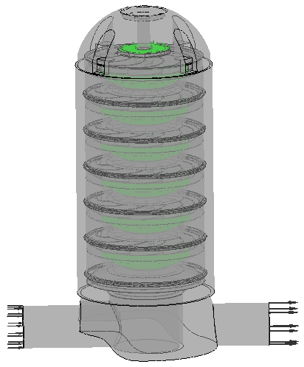

Impeller
Inlet
Outlet
Diffuser
Interface impeller-diffuser
Fig. 2

Slide 3
3/19 3/20 3/21 3/22 3/23 3/24 3/25 3/26 3/27 3/28 3/29 3/30 3/31 4/1
Time [h]
Fig. 3

Slide 4
Fig. 4

